Slide 1
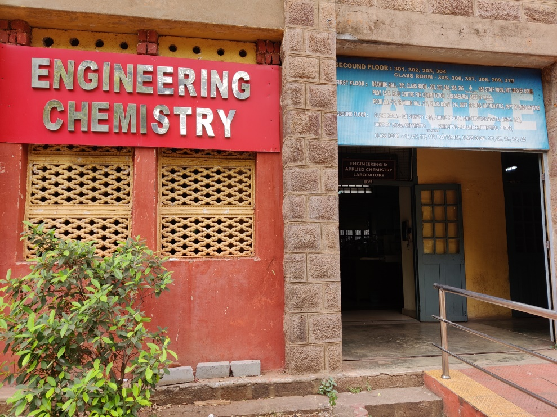
HEARTY WELCOME TO THE NAAC PEER TEAM
Department of
Engineering Chemistry
Andhra University

Slide 2
OVER VIEW
Vision & Mission
Department Profile/History/Achievement
Curricular Aspects
Teaching & learning
Research, Innovation and Extensions
Students support and Progression
Infrastructure and learning resources
Governance, leadership and Management
Institutional values and best practices
Progressive Plan

Slide 3
VISION AND MISSION OF THE DEPARTMENT
VISION:
To explore and advance in Frontiers of Knowledge in Chemical Sciences for the betterment of human life
MISSION:
To develop and apply the knowledge in chemical sciences, materials, environmental sciences, medicines and energy through teaching, research, innovation, collaboration and excellence

Slide 4
QUALITY OBJECTIVES
Andhra University is committed to achieving excellence in teaching, research and consultancy:
By imparting globally focussed education
By creating world class professionals
By establishing Synergic relationships with industry and society
By developing state of art infrastructure and well endowed faculty
By imparting knowledge through team work and incessant efforts

Slide 5
ENGINEERING CHEMISTRY DEPARTMENT
CELEBRATING 60 YEARS (1963-2023)
STARTED AS A CHEMISTRY SECTION IN 1963
PHD PROGRAMS COMMENCED FROM 1975
ELEVATED AS A DEPARTMENT IN 1979
SUBJECTS HANDLING FOR B.TECH. FIRST YEAR GREEN CHEMISTRY THEORY GREEN CHEMISTRY LAB A TWO YEAR M.SC. APPLIED CHEMISTRY PROGRAM WAS STARTED IN 1986

Slide 7
DEPARTMENT PROFILE CONTD…
NO. OF MAJOR RESEARCH PROJECTS COMPLETED 4
NO. OF MINOR RESEARCH PROJECTS COMPLETED 2

Slide 8
NO. OF PHDS PRODUCED 190
NO. OF M.PHILS PRODUCED ~60
NO. OF PAPERS PUBLISHED ~500

Slide 9
STUDENT ENROLMENT & DIVERSITY

Slide 10
STUDENT-FACULTY RATIO

Slide 11
CATERING TO STUDENT DIVERSITY
The actual stratification of students into slow, and advanced learners is based on their performance in the internal examinations and a continuous follow-up taken up thereafter till the course completion by the concerted efforts of teaching faculty, individual mentors and Head of the department.

Slide 12
PROGRAMS FOR ADVANCED LEARNERS
Bright and diligent students are motivated and inspired to get university ranks.
Semester toppers and university rank holders are honoured with certificates and cash prizes.
Encouraging to participate in various symposiums like quiz, poster presentation, Conferences, inter institution competition etc.
Guiding the students for NET/AP SLET/Competitive Examinations.
Guiding and encouraging to publish/present research papers in conferences/Journals
Training programs for gaining advanced technical knowledge.
Guiding for career planning, Student Project/ Entrepreneurship skills.

Slide 13
PROGRAMS FOR SLOW LEARNERS
Remedial classes conducted for Slow Learners.
Special Coaching class and Counseling is given to slow learners.
Previous year Question papers and Question Banks for all subjects are circulated among slow learners.
Students are given repeated practice on important questions.

Slide 14
TEACHING LEARNING PROCESS
Student centric methods
Participative Learning
Industry Interaction and Guest Lectures
Experiential Learning – Hands on Training in the Laboratories
Internship
Assignments

Slide 15
Faculty Centric Methods
ICT enabled tools including online resources for effective teaching and learning process
Conventional Lecture Methods
Use of Power point presentations
Use of Smart Boards
Project Guidance
Seminar Guidance

Slide 16
M.Sc. Applied Chemistry PEOs
Program EDucational Outcomes (PEOs)
PEO 1: The proficiency in the principles of basic and engineering sciences along with planning, analysis, design and execution of the chemical knowledge.
PEO 2: An ability to apply knowledge in chemistry for assessing the needs of the society for sustainable development and establishing positive chemical industry practices.
PEO 3: An attitude towards disseminating the knowledge acquired, continued learning, professional development and team spirit and promoting awareness of environmental concerns.
PEO 4: The professional ethics and social responsibilities through participatory approach Programme Outcomes (POs) after completion of the master’s degree, the graduate will acquire the abilities in the execution of chemical industry projects.

Slide 17
Program Outcomes (POs)
PO 1: Engineering Knowledge: Apply the knowledge of basic sciences and engineering fundamentals to solve engineering problems.
PO 2: Problem Analysis: Analyze the complex engineering problems and give solutions related to chemical & allied industries.
PO 3: Design/ development of solutions: Identify the chemical industrial problems, design and formulate solutions to solve both industrial & social related problems.
PO 4: Conduct investigations of complex problems: Design & conduct experiments, analyze and interpret the resulting data to solve Chemical Industrial problems.
PO 5: Modern tool usage: Apply appropriate techniques, resources and modern engineering & IT tools for the design, modelling, simulation and analysis studies.
PO 6: The engineer and society: Assess societal, health, safety, legal and cultural issues and their consequent responsibilities relevant to professional engineering practice.
PO 7: Environment and sustainability: Understand the relationship between society, environment and work towards sustainable development.
PO 8: Ethics: Understand their professional and ethical responsibility and enhance their commitment towards best chemical analysis practices.
PO 9: Individual and team work: Function effectively as a member or a leader in diverse teams, and be competent to carry out multidisciplinary tasks.
PO 10: Communication: Communicate effectively in both verbal & non-verbal and able to comprehend & write effective reports.
PO 11: Project management and finance: Understand the science, engineering and management principles to manage the multidisciplinary projects in whatsoever position they are employed.
PO 12: Life-long learning: Recognize the need of self-education and life-long learning process in order to keep abreast with the on-going developments in the field of chemical and pharmaceutical industries.

Slide 18
Program Specific Outcomes (PSOs)
The students who complete the M.Sc. Applied Chemistry course shall:
PS O1: Have strong foundation in the fundamentals and applications of chemical knowledge and understanding
PS O2: Have the abilities to think critically, logically and analytically and solve problem in the area of chemical sciences, materials, environmental aspects, medicines and energy
PS O3: Have the abilities to carry out chemical experiments, record and analyze the results and design advanced models
PS O4: Have the abilities to use modern library and information retrieving tools to obtain information and assimilate to generate concepts and apply them in challenging situations
PS O5: Have the abilities to effectively communicate their knowledge and skills to other chemists and non-chemists in oral or written formats
PS O6: Secure suitable employment in the areas of chemical industries like pharmaceutical, steel and metals, polymers, fuels and nuclear, environmental and pollution control, nanotechnology and composite materials, teaching and research, etc.
PS O7: Have the personal attributes and ethical sensibilities to enable them to function as effective scientists and citizens

Slide 19
Student Performance and Learning Outcomes
In strict compliance with the objectives of Outcome Based Education (OBE), the Program Outcomes (POs), Program Specific Outcomes (PSOs) and Course Outcomes (COs) are framed by the department offering the concerned program after rigorous consultation with all faculty and the stakeholders.

Slide 20
Attainment of program outcomes and course outcomes are evaluated by the institution
Each course has a defined set of course outcomes and corresponding evaluation criteria. The course outcomes are mapped to the program outcomes which are used to provide the quantitative measurement of how well the program outcomes are achieved.
The performance of the students in the examinations during the semester in each course is used to compute the level of attainment of the POs and PSOs through the mapping of questions to COs and COs to POs and PSOs. CO-PO & PSO mapping for all the courses in the program is prepared in consultation with other faculty members.

Slide 21
CO ATTAINMENT
Assessment methods include direct and indirect methods. The process of course outcome assessment by direct method is based on mid examinations, semester end examination and assignments.
Each question in mid/semester end/assignment is tagged to the corresponding CO and the overall attainment of that CO is based on average mark set as target for final attainment.
Mid Examinations are conducted twice a semester and each of them covers the evaluation of all the relevant COs attainment.
Semester End Examination is descriptive, and a metric for assessing whether all the COs are attained.
The indirect assessment is done through the course end survey.

Slide 22
Attainment of Program Outcomes and Program Specific Outcomes
All the courses which contribute to the PO are identified and these courses are evaluated through the Course Outcomes using direct (Internal (30% weightage) and External exam (70% weightage) and indirect (Course end survey) assessments.
The overall results from the assessments of the PO are compared with the expected attainment. The PO is considered satisfied on attainment of the expected level.
For each course, the level of attainment of each CO is compared with the predefined targets, If the target criterion level is not reached, then faculty suggest for improvement to attain the same.

Slide 23
CO Attainment levels
% CO Attainment | ≥ 70% | ≥ 60%<70% | ≥ 50%<60% | <50%
CO Attainment Level | 3 | 2 | 1 | 0
The attainment of each CO is computed by setting the class average mark as the target. The COs of each course are mapped to POs & PSOs with weightages of 3 (Strong), 2 (Medium) and 1 (Weak).

Slide 24
CO MAPPING FOR INORGANIC CHEMISTRY
Course Outcome | Overall CO Attainment | Level Attained 1/2/3
CO1 | 96.35 | 3
CO2 | 96.35 | 3
CO3 | 96.35 | 3
CO4 | 96.35 | 3
CO5 | 96.35 | 3
CO6 | 96.35 | 3
 | Final CO attainment of Course Name | 3

Slide 25
PO Mapping for Inorganic Chemistry
 |  |  | PO 1 | PO 2 | PO 3 | PO 4 | PO 4 | PO 5 | PO 6 | PO 7 | PO 8 | PO 9 | PO 10 | PO 11 | PO 12
Inorganic Chemistry | ACT 1.1 | CO1 | 3 |  | 3 | 2 | 2 | 2 | 2 |  |  |  |  | 2
 |  | CO2 | 3 |  | 3 | 2 | 2 | 3 |  | 2 |  |  |  | 1 | 2
 |  | CO3 | 3 | 3 | 2 | 3 |  | 3 |  | 2 |  | 2 |  | 1 | 3
 |  | CO4 | 3 | 2 | 3 | 3 | 2 | 2 |  | 3 |  | 2 |  |  | 3
 |  | CO5 | 3 | 3 | 3 |  | 2 |  |  |  |  |  |  | 2
 |  | CO6 | 3 |  | 2
 |  | Average | 3 | 2.7 | 2.7 | 2.5 | 2.0 | 2.5 | 2.0 | 2.3 |  | 2.0 |  | 1.5 | 2.7

Slide 26
OVERALL PO ATTAINMENT
S. NO. | POS | Direct Attainment | Indirect Attainment | Direct Attainment 70% | Direct Attainment 30% | Overall PO Attainment
1 | PO 1 | 3 | 2.75 | 2.1 | 0.825 | 2.925
2 | PO 2 | 2.67 | 2.43 | 1.869 | 0.729 | 2.598
3 | PO 3 | 2.67 | 2.5 | 1.869 | 0.75 | 2.619
4 | PO 4 | 2.5 | 2.3 | 1.75 | 0.69 | 2.44
5 | PO 5 | 2 | 2.4 | 1.4 | 0.72 | 2.12
6 | PO 6 | 2.5 | 2.3 | 1.75 | 0.69 | 2.44
7 | PO 7 | 2 | 2.3 | 1.4 | 0.69 | 2.09
8 | PO 8 | 2.33 | 2.2 | 1.631 | 0.66 | 2.291
9 | PO 9 | 2 | 2.1 | 1.4 | 0.63 | 2.03
10 | PO 10 | 2 | 2.2 | 1.4 | 0.66 | 2.06
11 | PO 11 | 2 | 2.2 | 1.4 | 0.66 | 2.06
12 | PO 12 | 1.5 | 2.2 | 1.05 | 0.66 | 1.71

Slide 27
IMPORTANT FEATURES OF M.Sc. APPLIED CHEMISTRY COURSE
https://www.andhrauniversity.edu.in/syllabus/new/APPCHEM-2021-22.pdf
COURSE CODE | SUBJECT | MODE | HOURS/ WEEK | EXTERNAL | INTERNAL | TORAL | HOURS/ WEEK | CREDITS
ACT 3.4 Elective | Medicinal Chemistry Energy Systems Surface Chemistry& Catalysis | Theory | 4/0/0 | 70 | 30 | 100 | 3 Hours | 4
ACT 3.5 | Research Methodology | Theory | 4/0/0 | 70 | 30 | 100 | 3 Hours | 2
ACT 3.6 | MOOC Course | Theory | 0/4/0 (Online) | 100 | - | 100 | As per the course | 2

Slide 28
COURSE CODE | SUBJECT | MODE | HOURS/ WEEK | EXTERNAL | INTERNAL | TORAL | HOURS/ WEEK | CREDITS
ACT 4.4 Elective | Green Chemistry Quantum Chemistry Nuclear Chemistry | Theory | 4/0/0 | 70 | 30 | 100 | 3 Hours | 4
ACT 4.5 | Intellectual Property Rights | Theory | 4/0/0 | 70 | 30 | 100 | 3 Hours | 2
ACT 4.6 | MOOC Course | Theory | 0/4/0 (Online) | 100 | - | 100 | As per the course | 2

Slide 29
COURSES WITH EMPLOYABILITY SKILLS WITH SPECIAL REFERENCE TO PHARMA & CHEMICAL INDUSTRIES
ORGANIC SYNTHESIS THEORY
ORGANIC SYNTHESIS LAB
ORGANIC SPECTROSCOPY
QUANTITATIVE ANALYSIS LAB
ANALYTICAL CHEMISTRY
FINE CHEMICALS
MEDICINAL CHEMISTRY
INDUSTRIES BASED ON ORGANIC RAW MATERIALS

Slide 30
COURSES WITH VALUE ADDED PROGRAMMES
ENVIRONMENTAL CHEMISTRY
INTELLECTUAL PROPERTY RIGHTS
RESEARCH METHODOLOGY

Slide 31
PROJECT WORKS FOR STUDENTS@
RINL, VIZAG STEEL PLANT
DR. REDDY’S LABS
APL PHARMA
LAURUS LABS

Slide 32
STUDENTS DETAILS

Slide 33
FEED BACK ANALYSIS

Slide 34
FACULTY PROFILE
S. No | Name of Faculty Member | Designation | Experience Yrs. | Highest Qualification | i10­– index
1 | Prof. B. Venkateswara Rao | Professor | 38 | Ph.D | 13
2 | Prof. K. Raghu Babu (Late) | Professor | 32 | Ph.D | 10
3 | Prof S. Paul Douglas | Professor | 32 | Ph.D | 11
4 | Prof N. Annapurna | Professor | 22 | Ph.D | 14
5 | Prof. K. Ramakrishna | Professor (A) | 35 | Ph.D | 19
6 | Dr. G. Hima Bindu | Associate Professor | 24 | Ph.D | 7
7 | Dr. B. Kishore Babu | Associate Professor | 18 | Ph.D | 13
8 | Dr. M. Padma | Associate Professor | 25 | Ph.D | 7
9 | Dr. M. Vijaya | Assistant Professor (C) | 20 | Ph.D | 3

Slide 35
STUDENT MENTORS: EVERY FACULTY ACTS AS A MENTOR FOR A SELECTED GROUP OF STUDENTS

Slide 36
FACULTY – PUBLICATIONS & CITATIONS

Slide 37
FACULTY H-INDEX & i-10 INDEX

Slide 38
RESEARCH PROJECTS
SOURCE OF FUNDING | PRINCIPAL INVESTIGATOR | CO-INVESTIGATOR | AMOUNT IN RUPEES
UGC | PROF. S. PAUL DOUGLAS | PROF. B. VENKATESWARA RAO | 10,48,220
UGC | PROF. N. ANNAPURNA | - | 2,60,000
DST-SERB | DR. B. KISHORE BABU | PROF. V. VEERAIAH | 10,28,130
DST-SERB | DR. M. PADMA | DR. B. GOVIND | 5,50,000
UGC-CSIR | PROF. S. PAUL DOUGLAS | MAJJI RAVIKUMAR | 13,87,287

Slide 39
AWARD OF RESEARCH DEGREES

Slide 40
NO OF SCHOLARS AND FELLOWSHIP HOLDERS

Slide 41
PATENTS FILED
Synthesis of Aryl Amides from Isocyanides and Carboxylic acids using ultrasound promoted inder ambient conditions – Dr. Bonige Kishore Babu – Patent Application Published
Development of Non Invasive Metal Oxide Semiconductor Nanocomposite Gas Sensor to Detect Diabetes using exhaled breath analysis – Dr. Bonige Kishore Babu – Patent Application Published

Slide 42
Teachers in Administrative Positions
2018-2021 – Prof. K. Raghu Babu – Registrar, Dr. B. R. Ambedkar University, Srikakulam
2020-2022 – Dr. S. Paul Douglas
Associate Dean, International Affairs and Chief-Warden, International Students Hostels, AU
Head of the Department
Chairman, BOS, Dept of Organic Chemistry, FD&W
Prof. B. Venkateswara Rao
Head of the Department
Chairman Board of Studies in Physical Chemistry

Slide 43
Teachers in Administrative Positions
Prof. N. Annapurna
Assistant Principal, AUCE 2014-2019
NODAL OFFICER, TEQIP-III 2018-2021
MEMBER, IPC, AUCE 2023 TILL DATE
HEAD OF THE DEPARTMENT 2021-TILL DATE
Dr. B. Kishore Babu
Hostel Warden – Block IV (2006-TILL DATE)

Slide 44
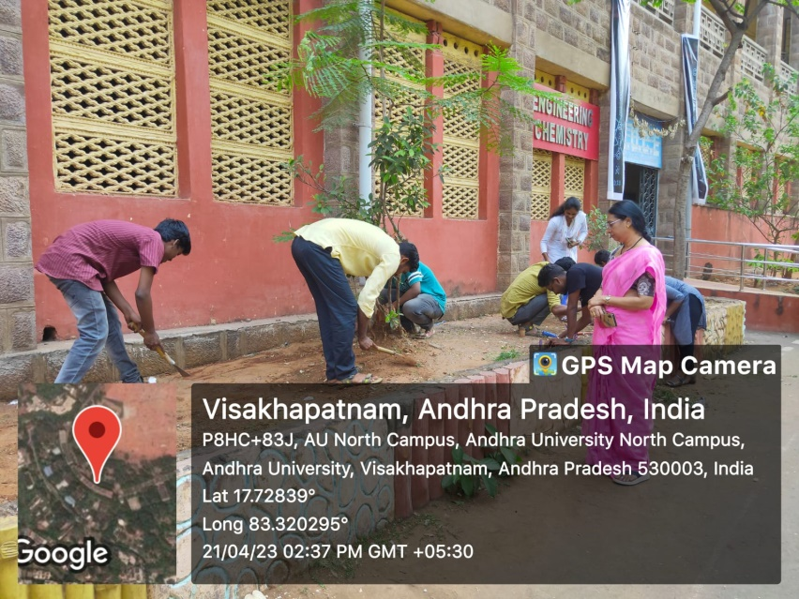
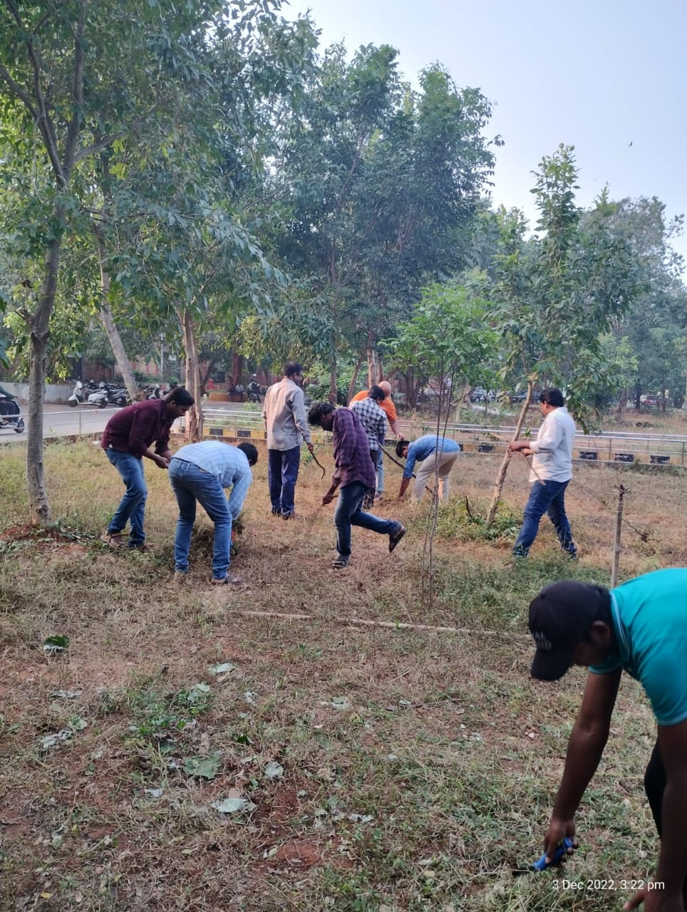
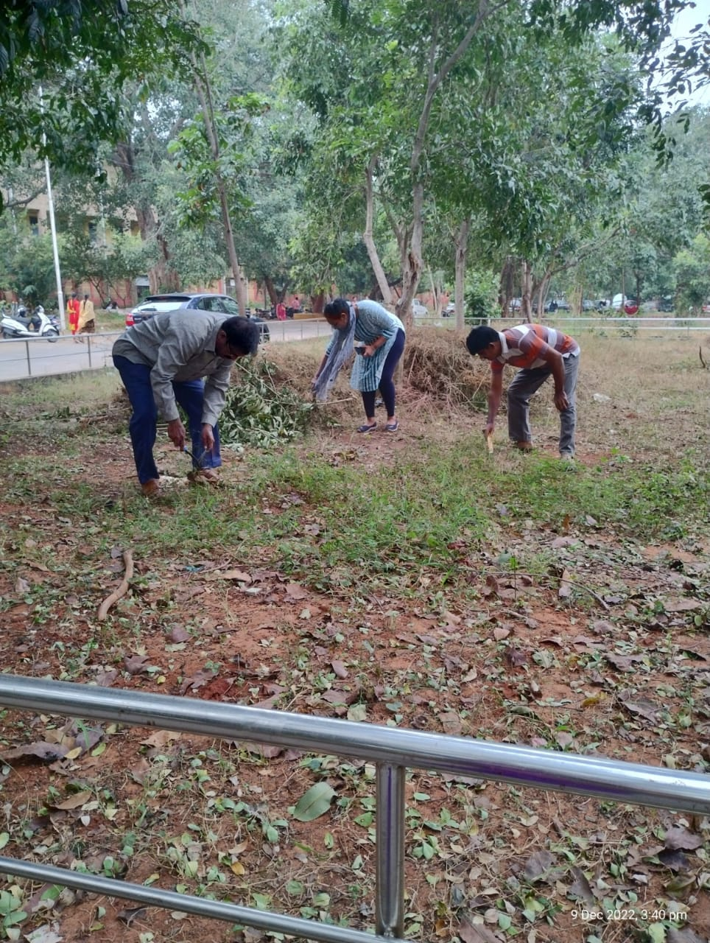
Extension and out reach programmes organized and participated (Swatch Bharath Activities)

Slide 45
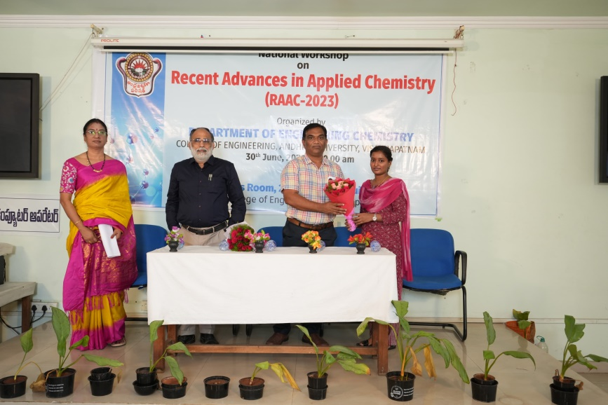
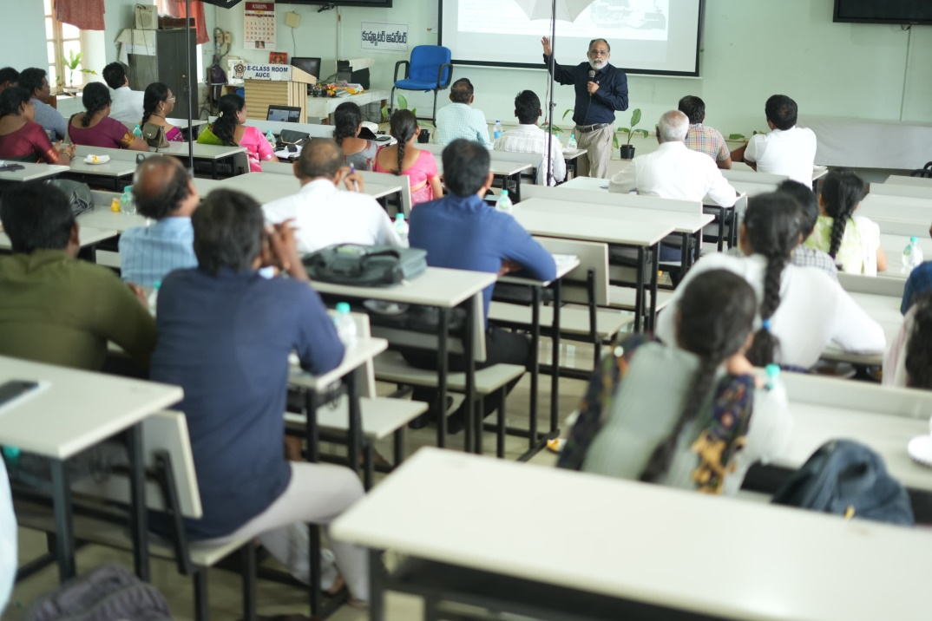
CONFERENCES AND SEMINARS CONDUCTED RAAC-2023
National Seminar

Slide 46
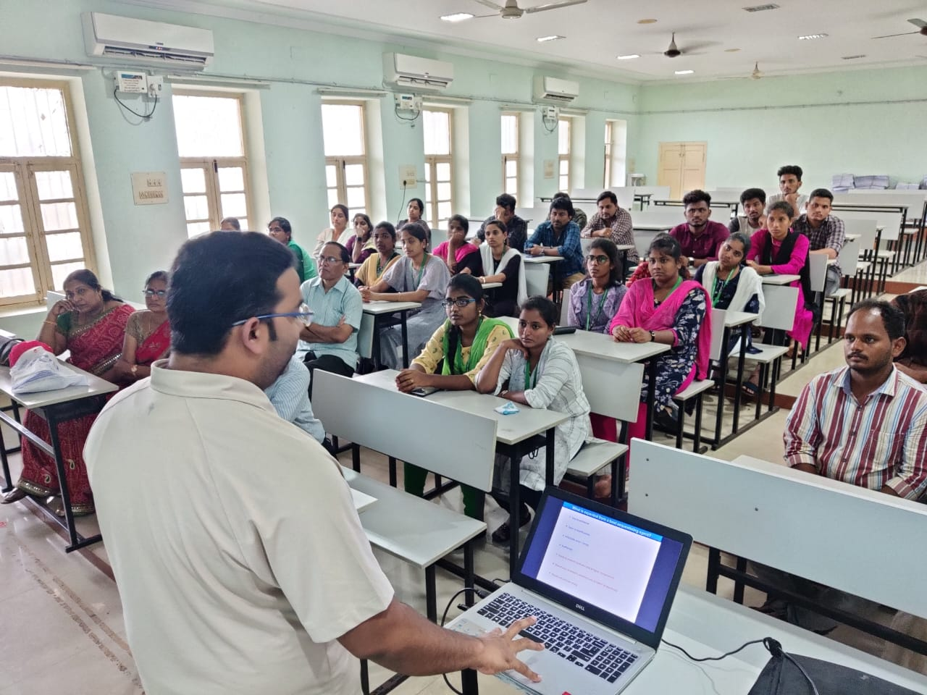
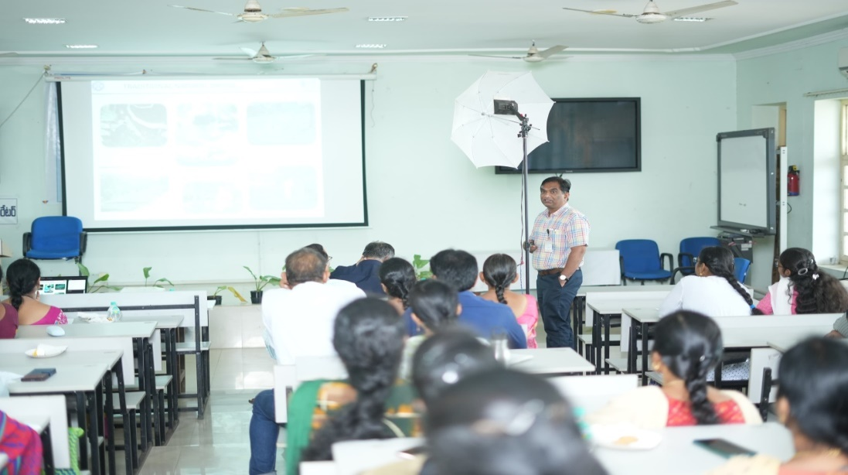
Guest Lectures by Eminent Professors
Guest Lectures

Slide 47
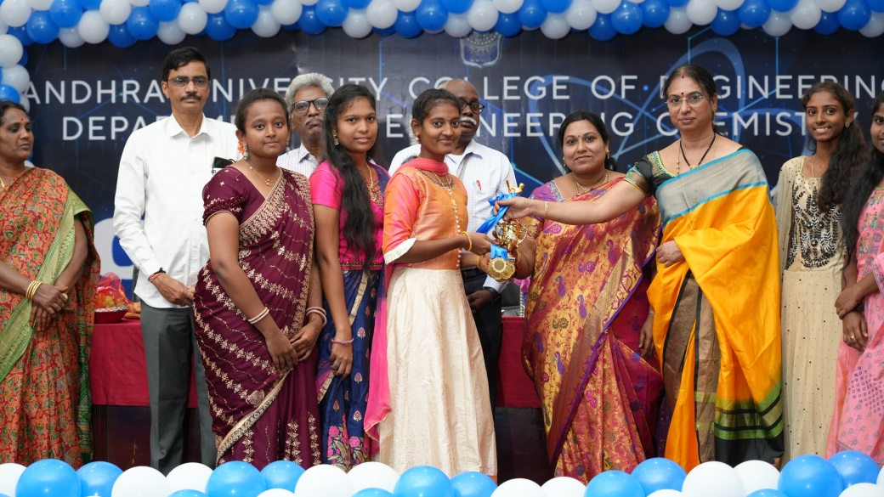
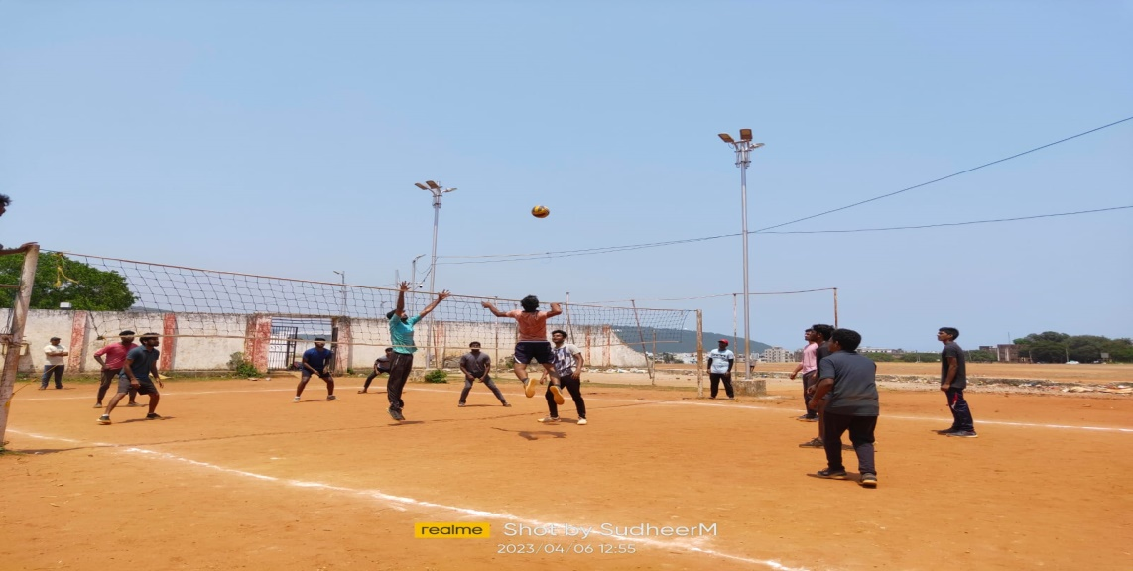
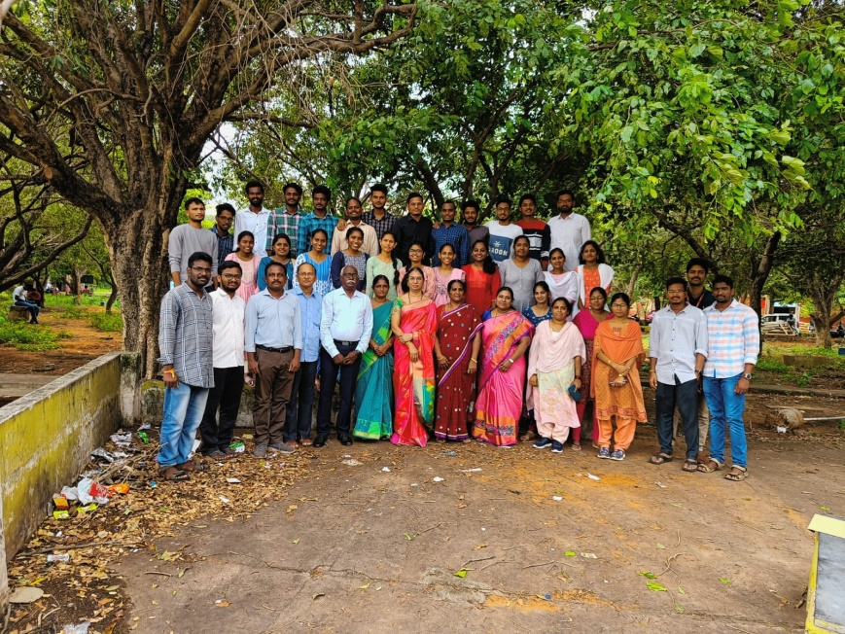
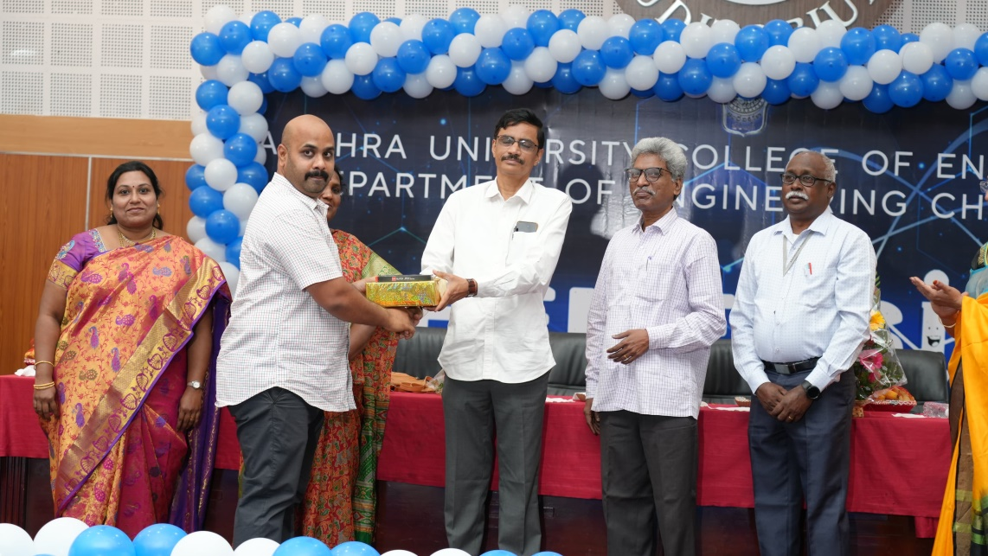
CULTURAL AND SPORTS ACTIVITIES Departmental Day Celebrations

Slide 48
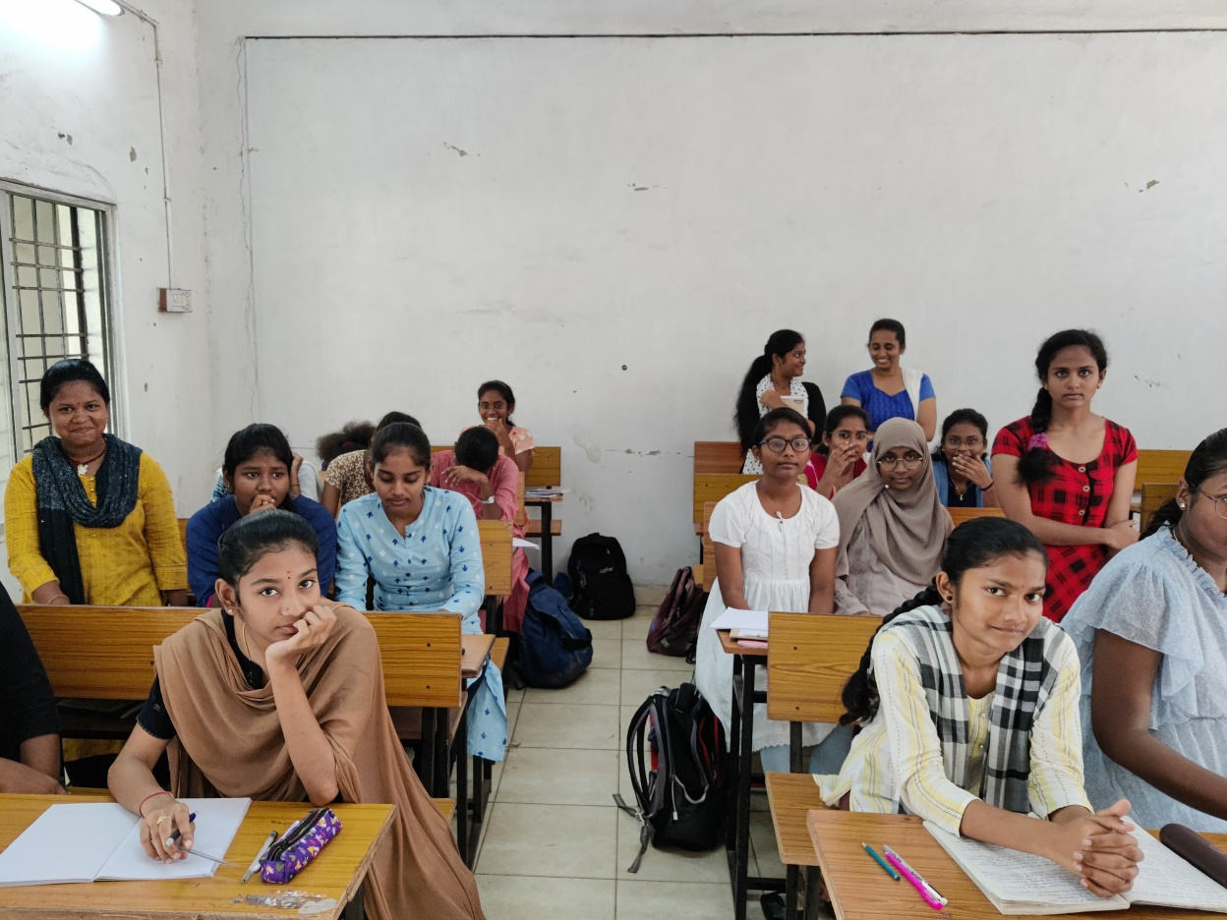
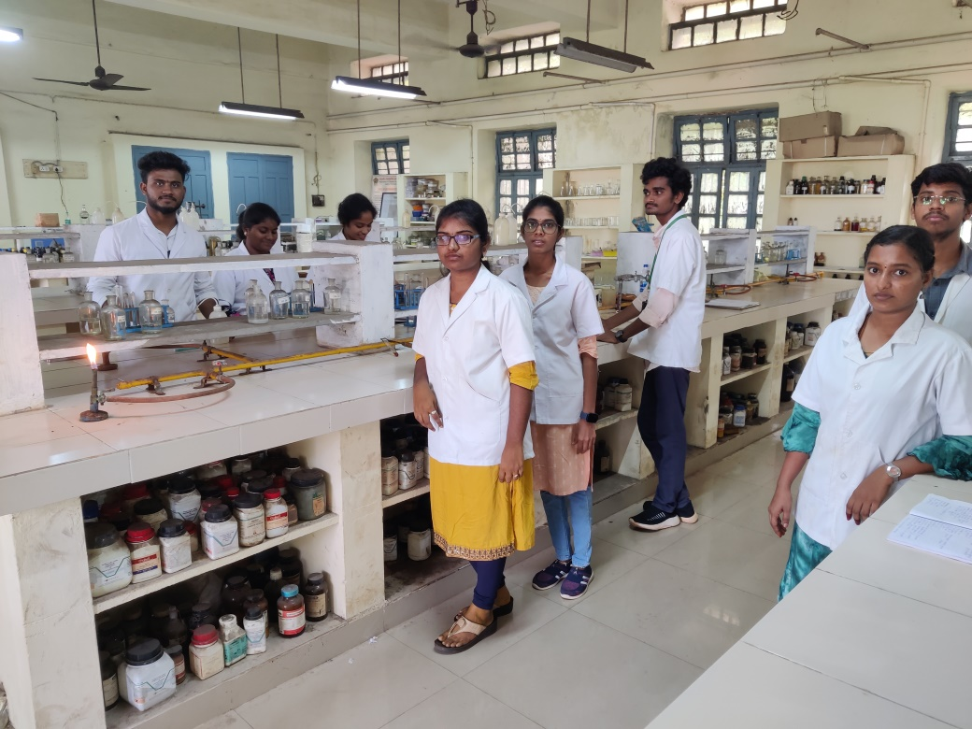
CLASSROOMS AND LABS

Slide 49
STUDENT PLACEMENTS

Slide 50
PROMINENT ALUMNI
Prof. C. Kamala Sastry, Professor, PNCO, AU
Prof. G. Lokeswara Reddy, Professor, Dr. LB College
Dr. Madhu Gowtham – Director & CEO Simhadri Labs
Dr. Srinivas Nallapati – Vice-President, Aurobindo Pharma Ltd
Dr. Gowri Shankar Kaki, GM (R&D), Hetero Research Foundation
Prof. L. Vaikunta Rao – Professor, GITAM University
Dr. Srinivas Garaga – DGM (R&D) – Hetero R&D

Slide 51
Chemical Waste Management
Solid Chemical Waste Management – Separation of Toxic Chemical bottles and disbursement to GVMC Toxic waste bins
Lab chemical waste water -
Waste water generated from the laboratories is very small in quantity; hence they are handled along with septic sewage.
RO plant waste water is diluted and used for gardening, watering trees etc.

Slide 52
BEST PRACTICES
Quality Teaching Learning Process
Hands on experience for all laboratory courses
Student centred education

Slide 53
FUTURE PLANS
Future Plans:
Enhancing best academic experience to students through teaching and instruction
Research projects to identify the young research minds and innovative ideas
Taking students to scientists and labs and bringing scientists to students
Modernisation of labs on par with industry and R&D

Slide 54
Thank You

